Slide 1
Lecture 9: Estimating Climate Damages using the Social Cost of Carbon
Prof. Theising
Environmental Economics Econ 4075

Slide 2
Climate Change and Economics
Climate economics aims to identify the relationship between the economy/welfare and the overall environment on earth.
But first, what do we mean by climate?
In general, we want to think about climate as a long-run conditions of the environment. A common window to define this is 30+ years.
But climate isn’t just mean (average) conditions of the environment (temperature, precipitations, etc.), we think of it encompassing higher order moments of environmental conditions’ distribution and more.
Frequency or severity of storms (think recent upticks on tropical storms, etc.), frequency and severity of draught or heat waves, ecological conditions and ocean pH, the interconnectedness of these, etc…
Even if these things are “on average” the same (annually, etc.) , their affect on economic outcomes could be very different.
Things we don’t even know about yet (unknown unknowns).

Slide 3
Where do we want to end up?
We’ve been discussing how to value benefits from the environment. Robust climate valuation is obviously trickier: impacts to the economy through many, many channels!
What we want is a single value measure of the benefit from a marginal reduction in carbon emissions…
Social cost of carbon:
“an estimate, in dollars, of the economic damages that would result (now and in the future) from emitting one additional ton of carbon dioxide into the atmosphere today.”
In illustrative terms: SCC measures the global damages to the world economy over the next 300 years from carbon you would emit while driving a Ford Mustang from SF to Chicago.
We typically use integrated assessment models to estimate the SCC
Can apply a similar exercise to other greenhouse gases

Slide 4
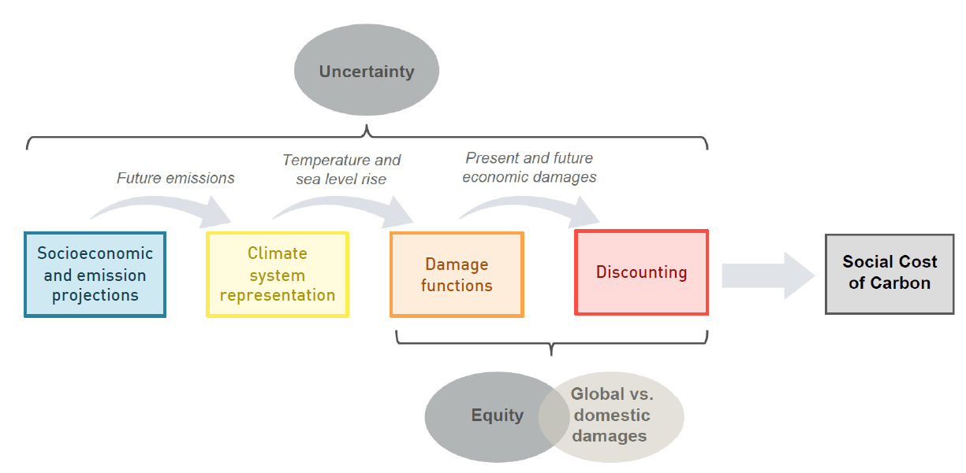
How to get to the SCC: a bio-macroeconomic model in 4 modules
This part, the SCC, is the difference between the baseline model and the model with an extra ton of carbon dioxide

Slide 5
Let’s work backwards, step by step…

Slide 6
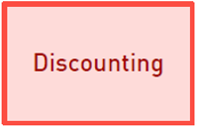
Discounting
In thinking about climate change, we know that many of the effects will occur in the long run.
A key question is how to compare benefits of mitigating climate effects way down the road (60+ years from now), to costs that we incur today.
Economists (and our finance/policy peers) generally use a discount rate: a value that tells us how much future dollars are worth in today’s terms.

Slide 7
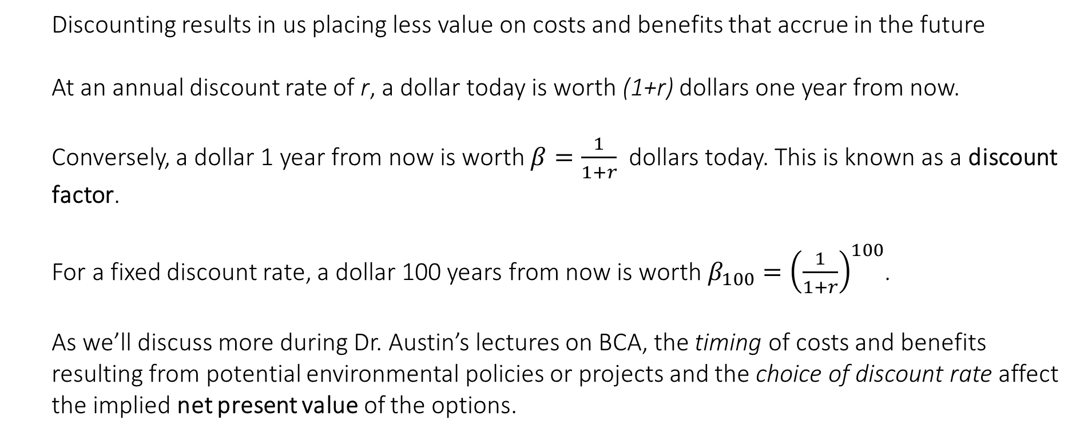
Discounting
Discounting results in us placing less value on costs and benefits that accrue in the future
At an annual discount rate of r, a dollar today is worth (1+r) dollars one year from now.
Conversely, a dollar 1 year from now is worth $β=\frac{1}{1+r}$ dollars today. This is known as a discount factor.
For a fixed discount rate, a dollar 100 years from now is worth $β_{100}={\left(\frac{1}{1+r}\right)}^{100}$.
As we’ll discuss more during Dr. Austin’s lectures on BCA, the timing of costs and benefits resulting from potential environmental policies or projects and the choice of discount rate affect the implied net present value of the options.

Slide 8
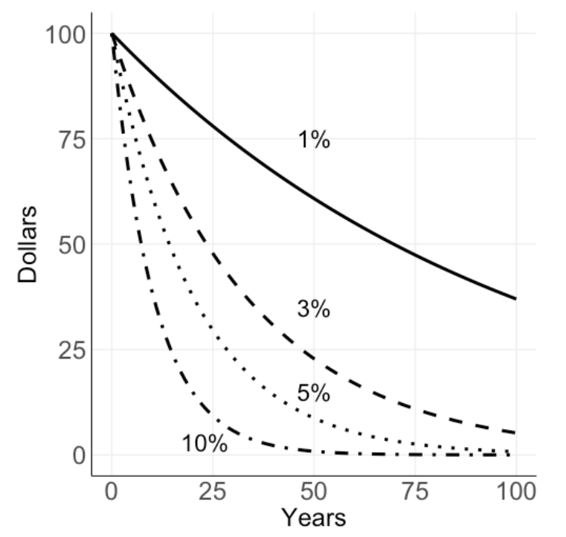
Present value of $100
Higher discount rates place less value on future benefits.
With a discount rate of 10%, $100 received 50 years in the future has basically zero present value.
Contrast with a discount rate of 1%: $100 received 100 years in the future holds roughly $40 in present value.

Slide 9
Let’s use some larger numbers
$1 billion in climate damages that occurs 200 years from now, when discounted at a 2% rate, has a present value of roughly $19 million.
$1 billion in climate damages that occurs 200 years from now, when discounted at an 8% rate, has a present value of roughly $21,000.
The punchline: this parametric “lever” is probably the most contentious number in environmental economics.

Slide 10
So how do we choose a discount rate?
Option 1: take the market rate (i.e. the real interest paid on investments)
You could argue for something like the return on Treasury notes (typically seen as risk free) or corporate bonds (riskier).
Could also argue for something that more fully captures the productivity of capital investments – perhaps the long-run market return of the S&P 500.
As a regulator, however, there might be reasons we don’t like this approach:
Market rates do not reflect externalities
Government represents future generations as well as current generations… only current generations are represented in the market.

Slide 11
So how do we choose a discount rate?
Option 2: social discounting
We can use economic and ethical considerations to justify and determine the rate.
Why discount at all?
We know there is a time value to money: people are impatient.
We know that there is diminishing utility from consumption and typically expect economic growth: all else equal, if someone is richer in 10 years, a dollar is worth more to them today that in 10 years.
We use what is known as the Ramsey discounting rate to accommodate these considerations

Slide 12
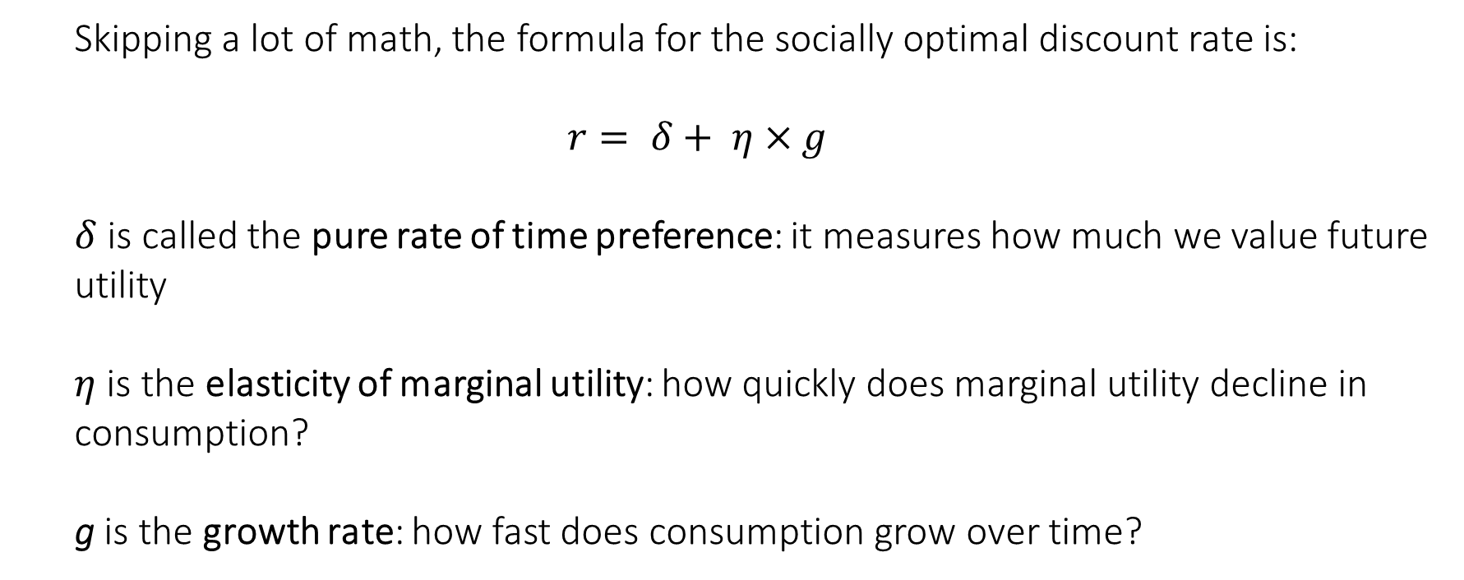
Ramsey discounting
Skipping a lot of math, the formula for the socially optimal discount rate is:
$$r= δ+ η×g$$
$δ$ is called the pure rate of time preference: it measures how much we value future utility
$η$ is the elasticity of marginal utility: how quickly does marginal utility decline in consumption?
g is the growth rate: how fast does consumption grow over time?

Slide 13
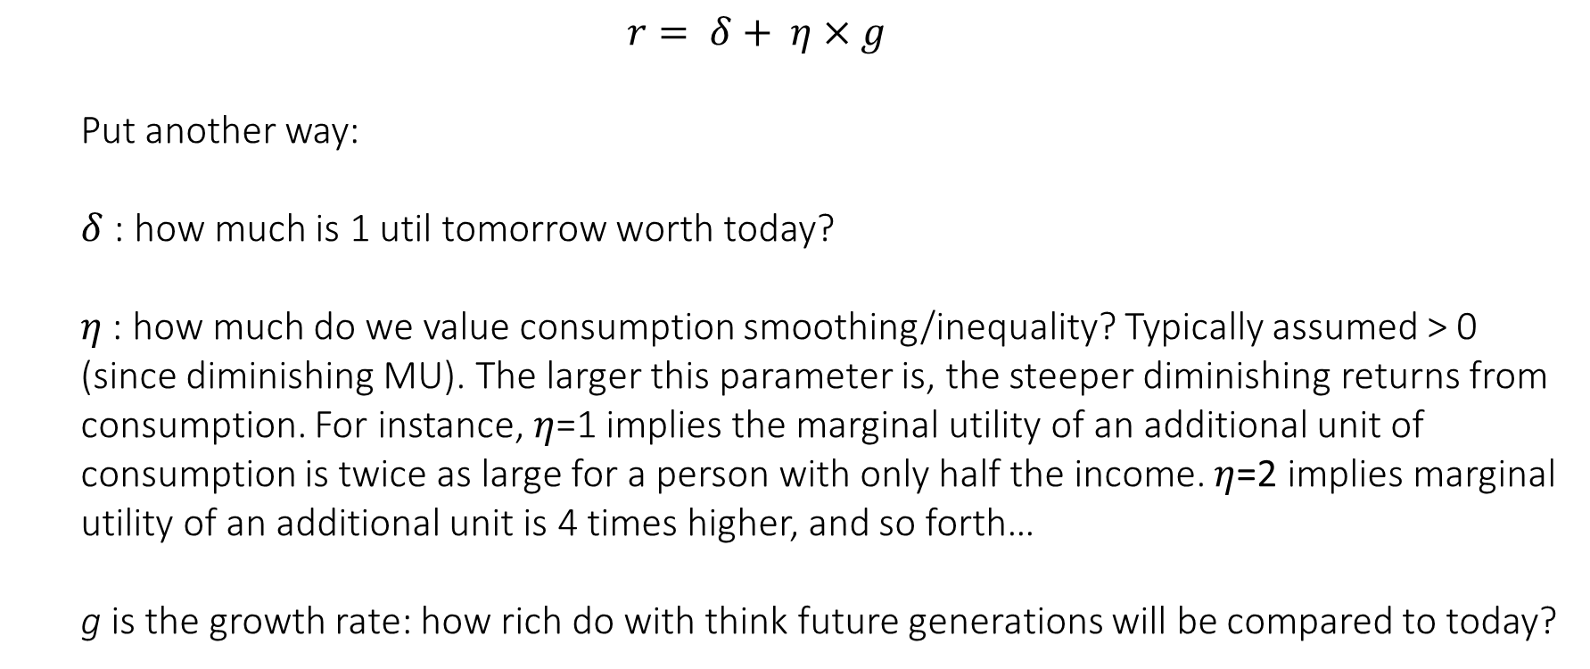
Ramsey discounting
$$r= δ+ η×g$$
Put another way:
$δ$ : how much is 1 util tomorrow worth today?
$η$ : how much do we value consumption smoothing/inequality? Typically assumed > 0 (since diminishing MU). The larger this parameter is, the steeper diminishing returns from consumption. For instance, $η$=1 implies the marginal utility of an additional unit of consumption is twice as large for a person with only half the income. $η$=2 implies marginal utility of an additional unit is 4 times higher, and so forth…
g is the growth rate: how rich do with think future generations will be compared to today?

Slide 14
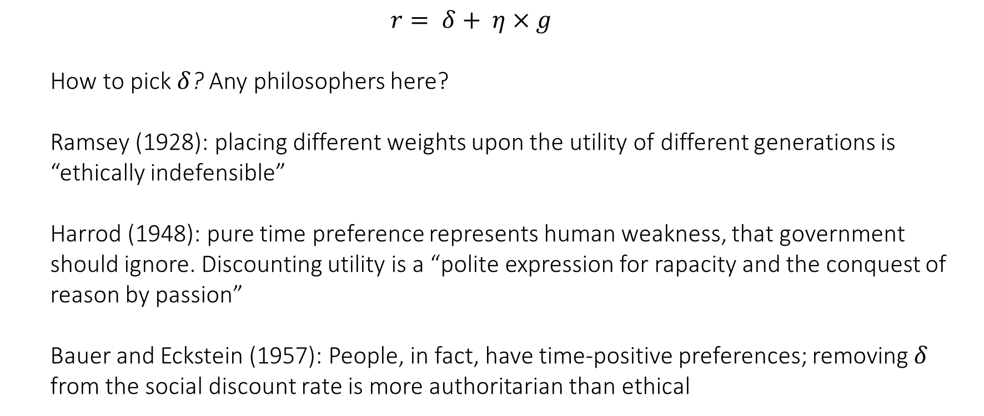
Ramsey discounting
$$r= δ+ η×g$$
How to pick $δ$? Any philosophers here?
Ramsey (1928): placing different weights upon the utility of different generations is “ethically indefensible”
Harrod (1948): pure time preference represents human weakness, that government should ignore. Discounting utility is a “polite expression for rapacity and the conquest of reason by passion”
Bauer and Eckstein (1957): People, in fact, have time-positive preferences; removing $δ$ from the social discount rate is more authoritarian than ethical

Slide 15
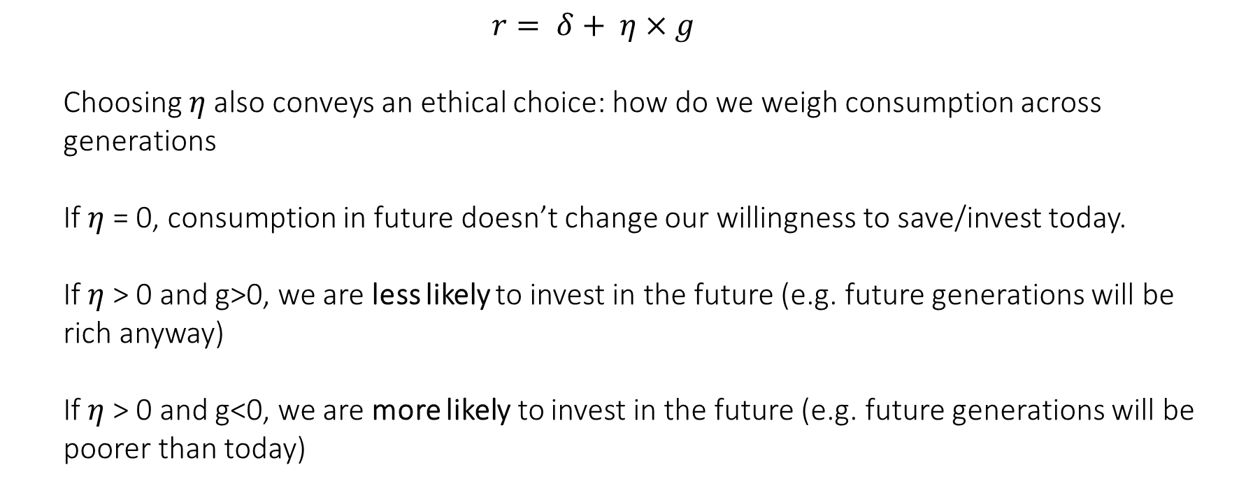
Ramsey discounting
$$r= δ+ η×g$$
Choosing $η$ also conveys an ethical choice: how do we weigh consumption across generations
If $η$ = 0, consumption in future doesn’t change our willingness to save/invest today.
If $η$ > 0 and g>0, we are less likely to invest in the future (e.g. future generations will be rich anyway)
If $η$ > 0 and g<0, we are more likely to invest in the future (e.g. future generations will be poorer than today)

Slide 16
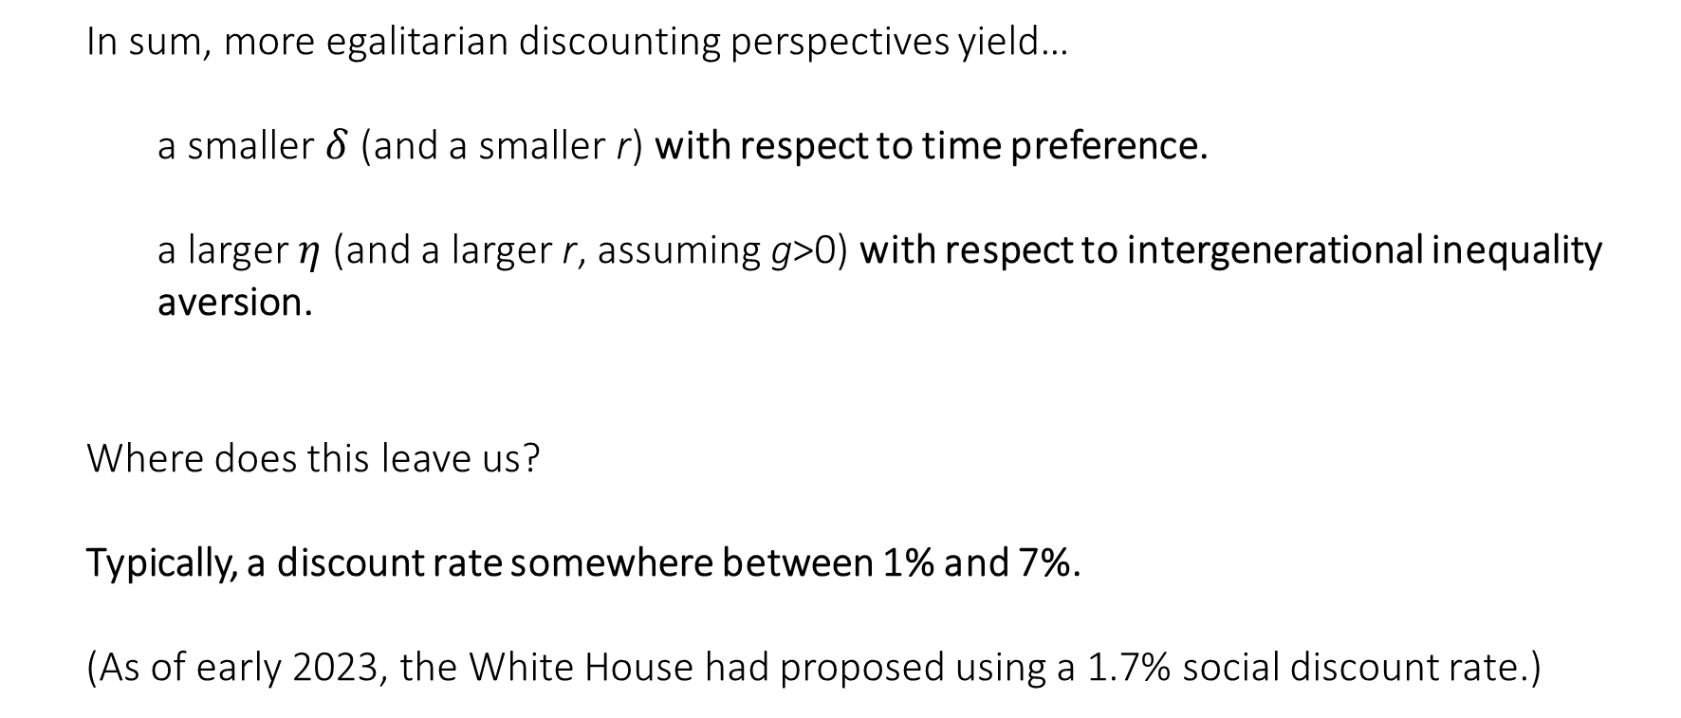
Ramsey discounting
In sum, more egalitarian discounting perspectives yield…
a smaller $δ$ (and a smaller r) with respect to time preference.
a larger $η$ (and a larger r, assuming g>0) with respect to intergenerational inequality aversion.
Where does this leave us?
Typically, a discount rate somewhere between 1% and 7%.
(As of early 2023, the White House had proposed using a 1.7% social discount rate.)

Slide 17
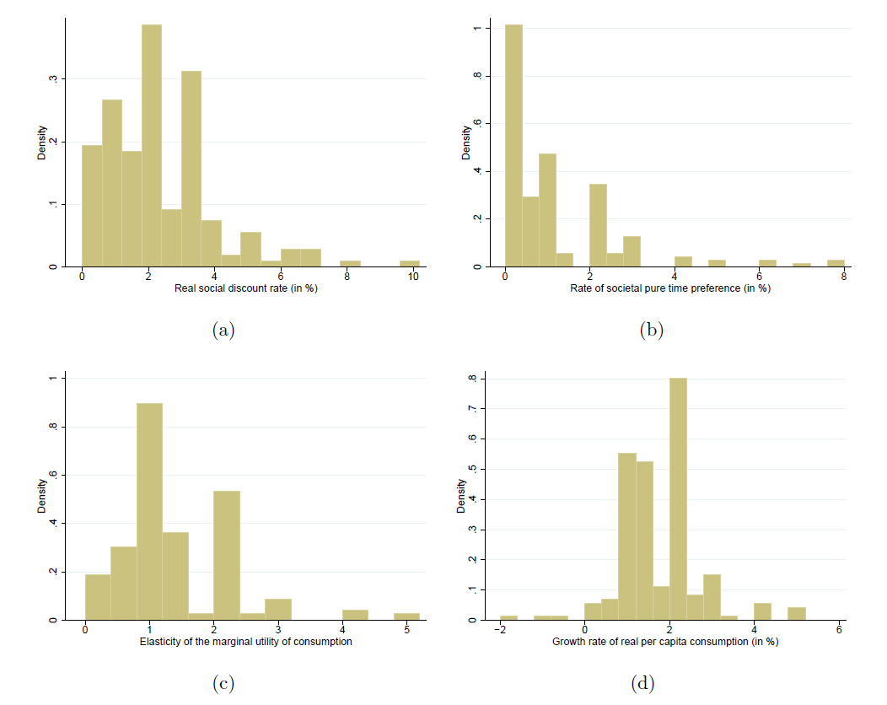
What do the experts think?
From Drupp et al. (2018): “Discounting Disentangled”, AEJ:EP

Slide 18
Calculating Economic Damages from Climate Change
So we’ve thought a bit about how to discount future damages.
Our next step, working backwards, is to produce estimates of damages over time.
To do this, we need to translate long-run changes in the climate into measures of economic damages.
Broadly speaking, there are two ways of getting at this: a top-down approach, or bottom-up / sectoral approach.

Slide 19
Top-down approaches to measuring economic damages
Top-down studies attempt to directly estimate the effect of climate change on aggregate outcomes like GDP
Empirical work estimating these damage functions typically use previous short-term variations in weather over space to identify how GDP responds to a distribution of temperature.
The idea is that this estimated relationship can then be used to project how the aggregate economy performs in the future as it is exposed to a different distribution of weather/climate.

Slide 20
Top-down approaches to measuring economic damages
Advantages:
Easy to plug-and-play with existing macroeconomic models that rely on these aggregate measure but lack climate effects
Top-down approach theoretically captures all sector impacts and feedbacks/interactions between them

Slide 21
Top-down approaches to measuring economic damages
Disadvantages?

Slide 22
Top-down approaches to measuring economic damages
Disadvantages:
These approaches miss slow-moving damage channels like sea-level rise and ocean acidification. They cannot be empirically identified, and/or data might not yet exist.
These approaches may struggle to account for adaptation (foreseen, or not), and projections based on their damage functions could be biased (most likely upward)
These approaches are based on historical data, requiring projections out of sample and/or strong functional form assumptions on the damage function
These approaches rely on GDP as a welfare measure, and might miss crucial climate impacts like human health, accumulated wealth, or migration.

Slide 23
Bottom-up approaches to measuring economic damages
Instead of looking at aggregate GDP impacts directly, we can focus on carefully identifying the empirical impacts of climate on specific economic sectors or categories of damages.
This is exercise wonderfully useful because we can:
(a) Aggregate up sectoral climate damages into a total impact to GDP, and
(b) Use what we learn about expected sectoral impacts for planning, vulnerability assessment and adaptation.
Because we are doing this bottom-up, we can use different methodological/econometric/ statistical approaches to identifying separate climate impacts; i.e. use the best tool to measure the impact of climate change on an individual economic channel.
This is still a hard problem… why?

Slide 24
The ideal experiment for measuring climate damages
Randomized Control Trials (RCTs) are the gold standard for identifying causal relationships. What would an experiment (RCT) look like in the case of estimating the causal relationship between climate and the economy?
Ideal: Many earths, where we can pump a varying amount of carbon dioxide into the atmosphere to change the climate. Examine the differences between the treatment and control earths over the next several hundred years.
What we have: One earth and some quasi-experimental econometrics methods that identify model parameters from variation in historical observation (either cross-sectional or panel).

Slide 25
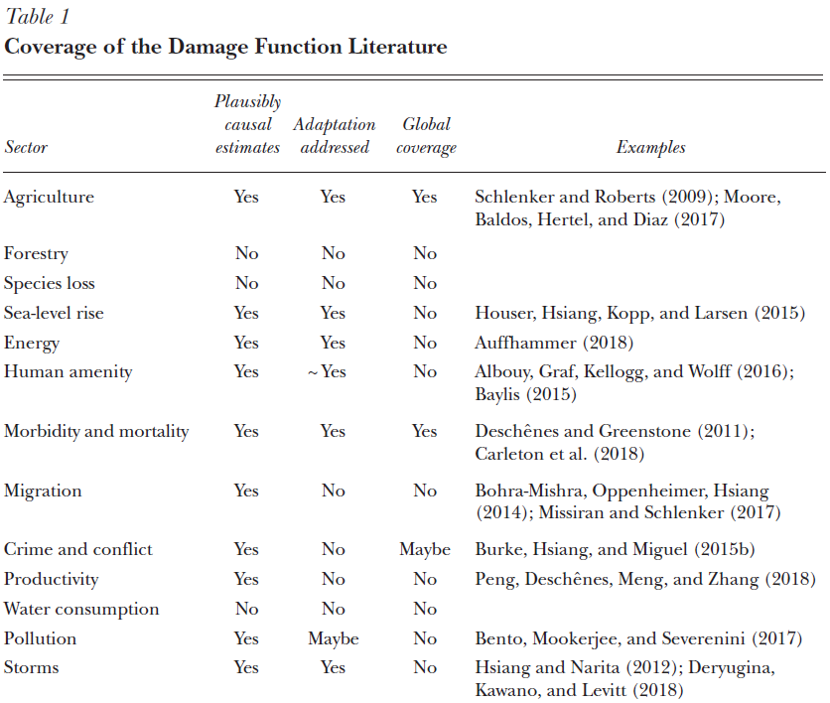
Where we stand in terms of sectoral/categorical climate impacts (circa-2020)
Source: Auffhammer (2018, JEP)

Slide 26
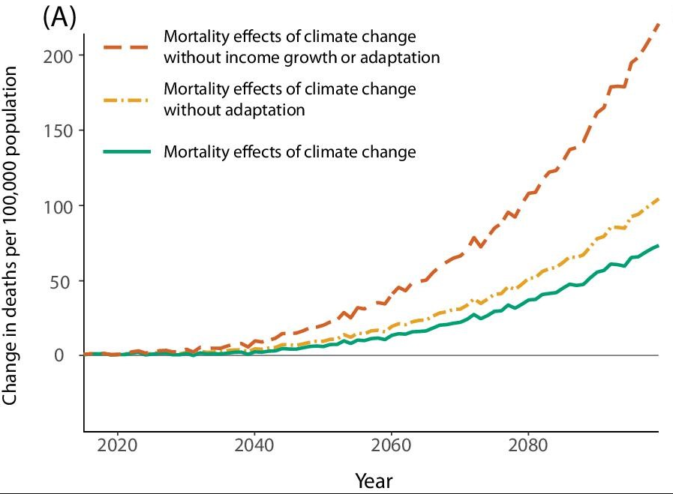
Improving on naïve climate econometrics
Example: What is the effect of climate on global mortality?
Very hot and very cold temperatures are both bad for mortality, what's the overall effect of climate change?
Difficult to account for adaptation: people will migrate, buy air conditioning, etc.
Failing to account for adaptation will overstate the effect of climate change. See Carleton et al. 2022 for a nice empirical treatment of mortality risk adaptation.

Slide 27
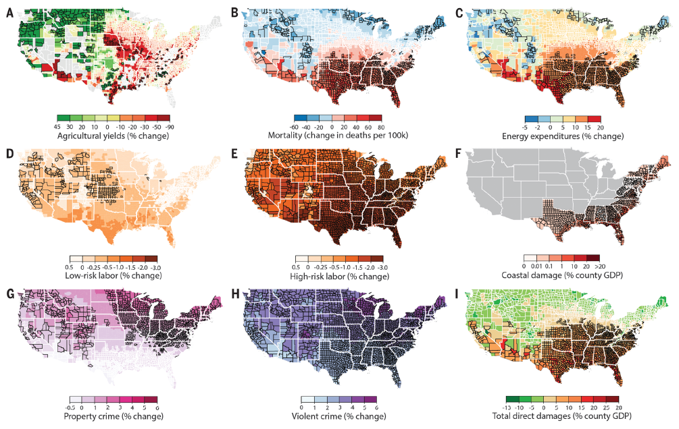
Aggregating up to GDP from sectors…
Source: Hsiang et al. (2017, Science)

Slide 28
Modelling climate responses to anthropogenic activities
Our next step, still working backwards, is to produce an input for our damage functions.
If we are measuring damages over time as a function of climate, we need measurements of how the climate is evolving.
These climate measurements can be simple (global mean surface temperature [GMST] is a single-attribute statistic often used for climate) or complex (including temperature, precipitation, sea level rise, ocean acidification, and more).
Climate models formally characterize the relationships between emissions (input variable, a flow) and atmospheric CO2 concentrations (a stock), and the resulting changes in climate
Many flavors exist in complete IAMs. Some currently notable climate modules: FaIR, BRICK

Slide 29
Forecasting future economic activity and emissions
Finally, the first step is to produce forecasts of population, industrial economic activity, and ultimately CO2 emissions, to input into the climate module.
The socioeconomic projection module forecasts emissions based on models generated by demographers and macroeconomists.
Some of the best modelling to date tries to account for future intermediate-term policy changes and for dependencies across socioeconomic variables; it also incorporates both statistical frameworks and solicited expert judgment about the evolution of demographics and activity in the very long run.
We use these socioeconomic projection models to calculate CO2 emissions over time. These models could calculate emissions under “business-as-usual” or climate policy scenarios; the baseline case is often set as the former, but in some instances, it might make sense to use non-BAU climate policy scenarios as a baseline.

Slide 30
Additional “modules” of an IAM

Slide 31
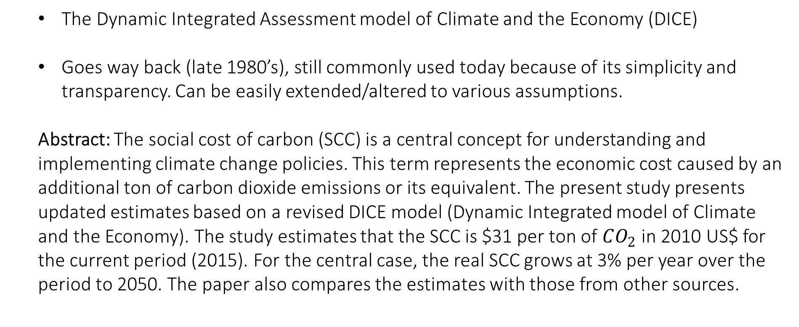
Revisiting the social cost of carbon
By: Nordhaus (2017)
The Dynamic Integrated Assessment model of Climate and the Economy (DICE)
Goes way back (late 1980’s), still commonly used today because of its simplicity and transparency. Can be easily extended/altered to various assumptions.
Abstract: The social cost of carbon (SCC) is a central concept for understanding and implementing climate change policies. This term represents the economic cost caused by an additional ton of carbon dioxide emissions or its equivalent. The present study presents updated estimates based on a revised DICE model (Dynamic Integrated model of Climate and the Economy). The study estimates that the SCC is $31 per ton of $CO_{2}$ in 2010 US$ for the current period (2015). For the central case, the real SCC grows at 3% per year over the period to 2050. The paper also compares the estimates with those from other sources.

Slide 32
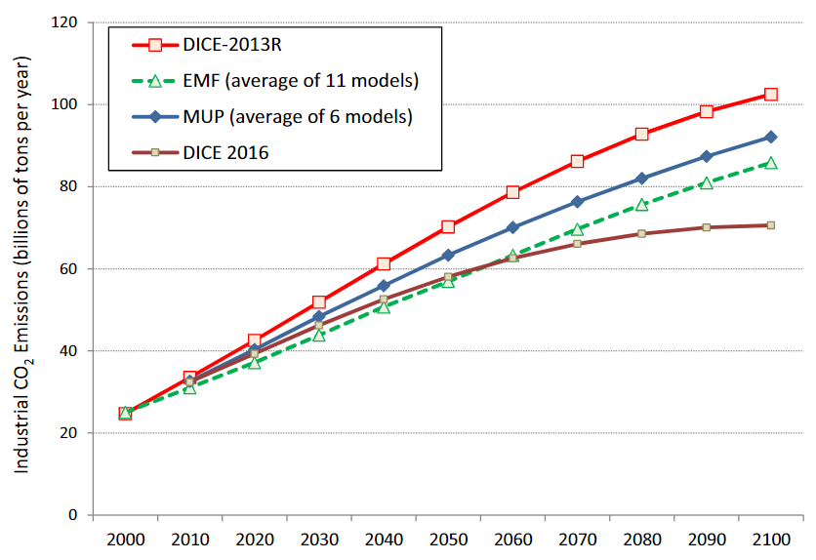
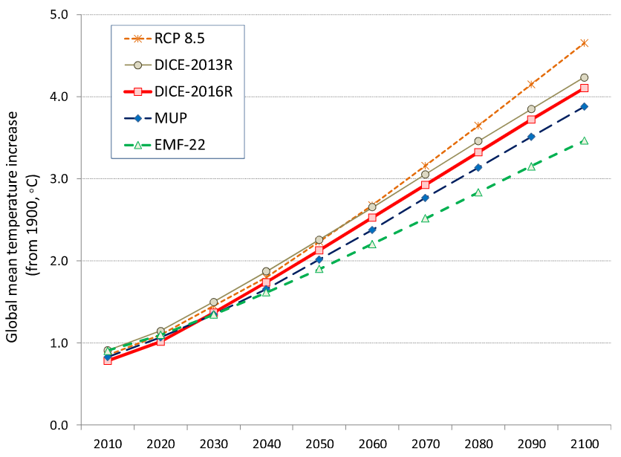
Revisiting the social cost of carbon
By: Nordhaus (2017)

Slide 33
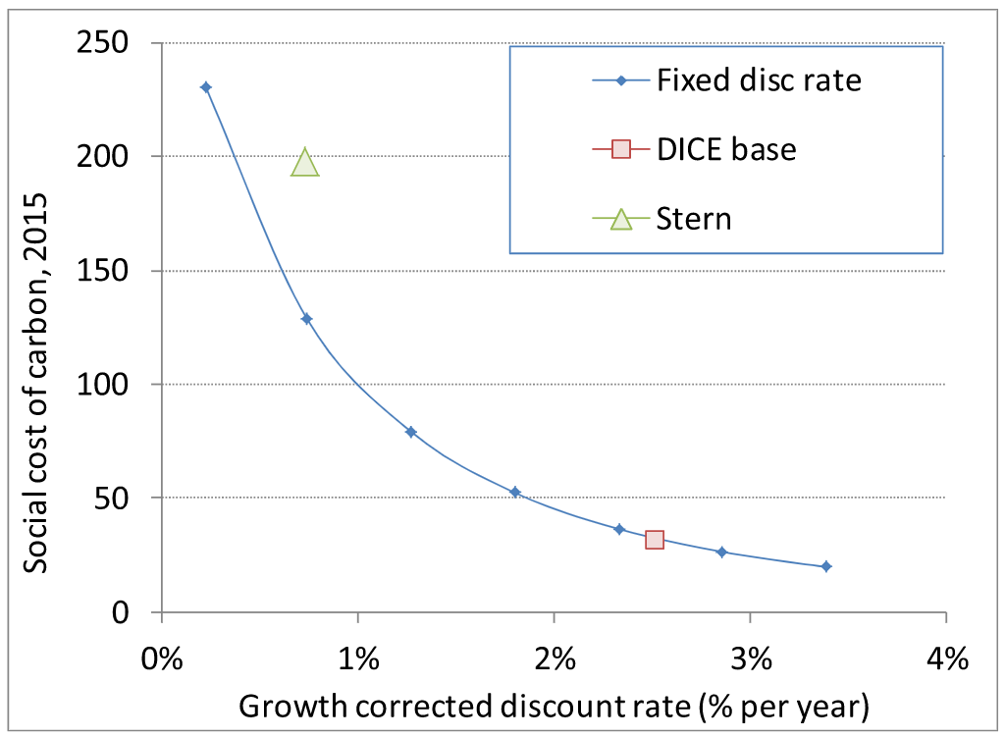
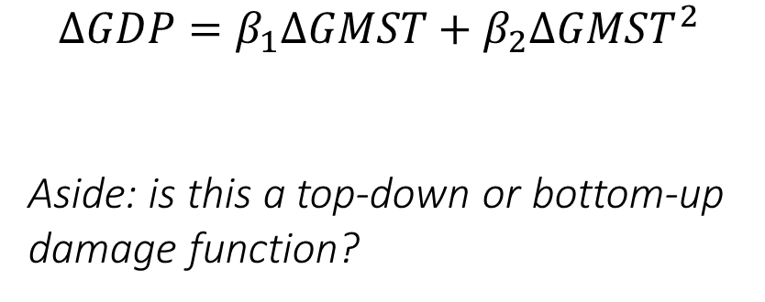
Revisiting the social cost of carbon
By: Nordhaus (2017)
$$ΔGDP=β_{1}ΔGMST+β_{2}ΔGMST^{2}$$
Aside: is this a top-down or bottom-up damage function?

Slide 34
Social Cost of Carbon Explorer
Resources for the Future has a nice point-and-click IAM (with fixed parameterizations) available to play with on their website https://www.rff.org/publications/data-tools/scc-explorer/ I recommend exploring it a bit on your own time to better understand the inputs/outputs of each module, and the underlying assumptions.

Slide 35
Next class
Accounting for Natural Capital:
K&O (textbook) Chapter 11
Fenichel podcast
An Almost Practical Step Toward Sustainability (Solow Monograph)
Heads up: Case Study #2 – applying a simple R version of the DICE model!
Will post the code files in the next day or so (likely with a slightly delayed due date relative to what’s listed on syllabus.)
Please, please start early on this and come to us with questions!
I will hold open office hours via Zoom this Friday, 4-5pm. See Canvas for details

Slide 36
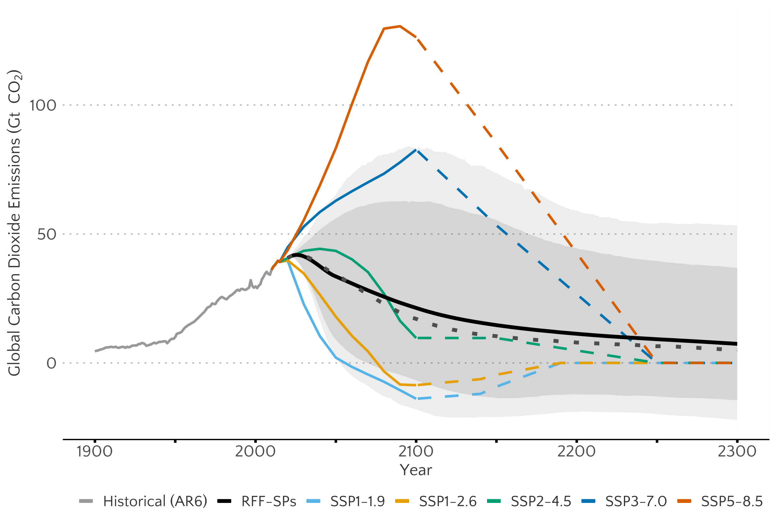
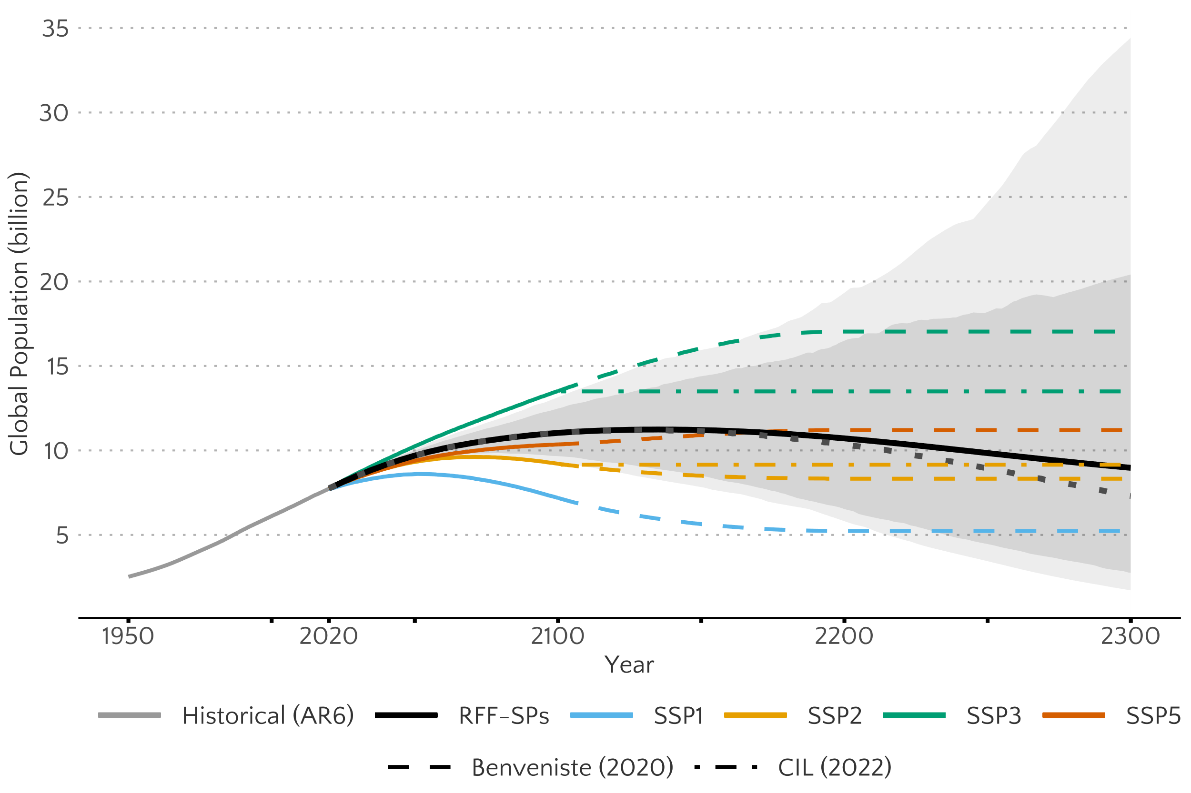
Appendix: Life Beyond DICE - Rennert et al. (2022)
Statistical probabilistic growth scenarios linked to emissions

Slide 37
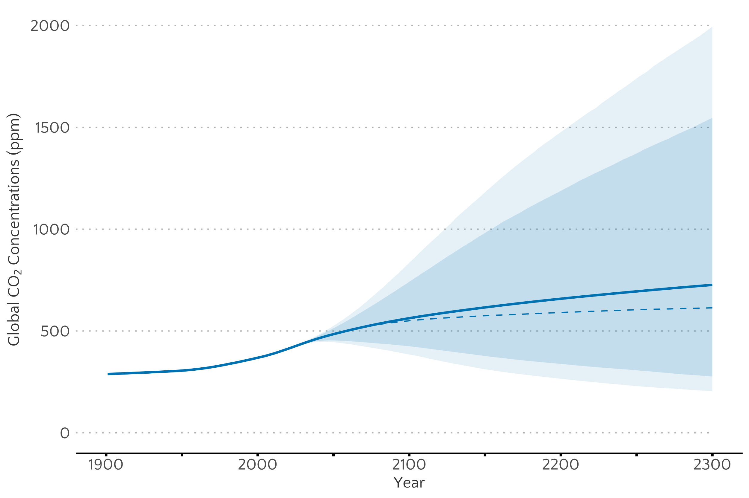
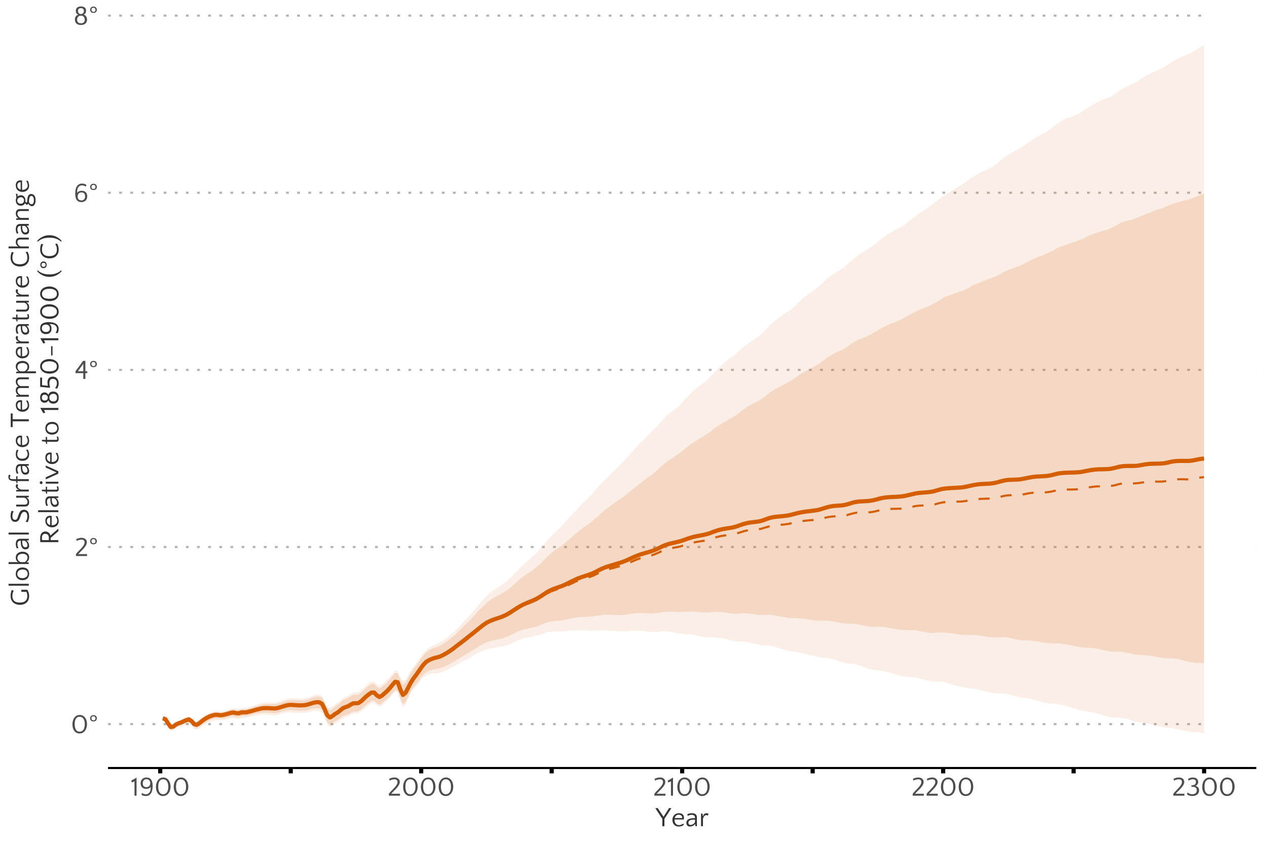
Appendix: Life Beyond DICE - Rennert et al. (2022)
Reduced complexity climate systems model – FaIR1.6

Slide 38
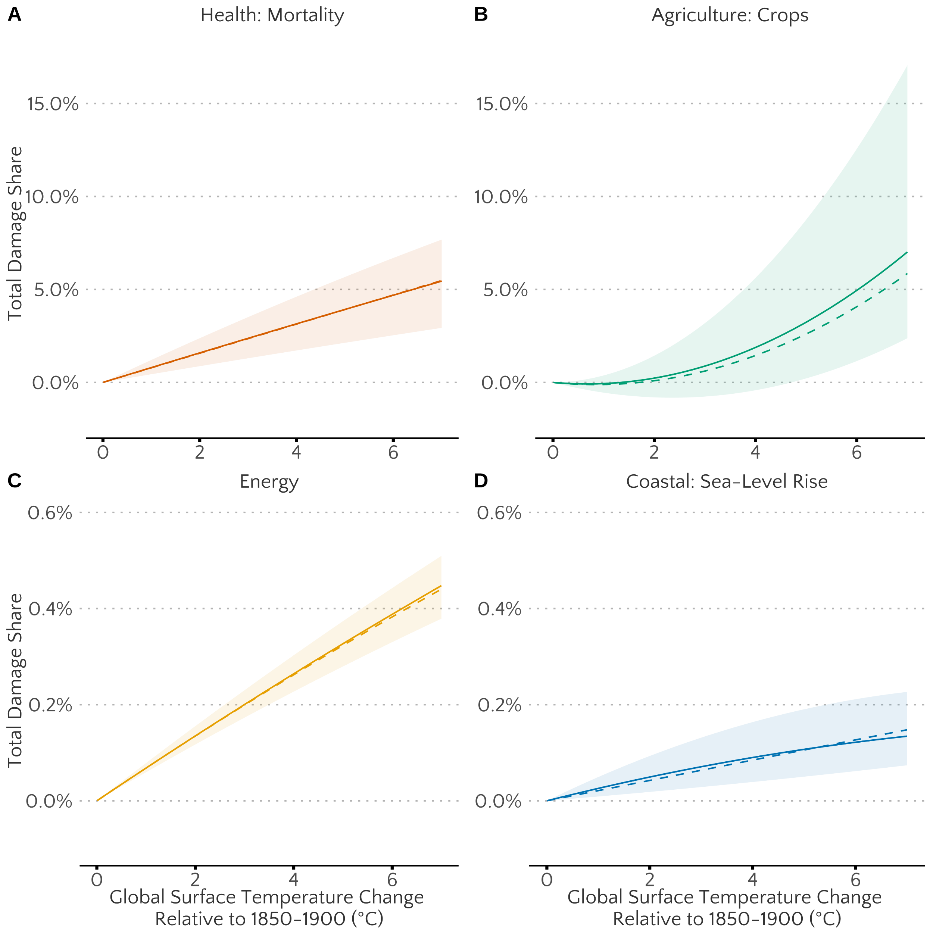
Appendix: Life Beyond DICE - Rennert et al. (2022)
Four-sector damage function at the country-level (184 regions)

Slide 39
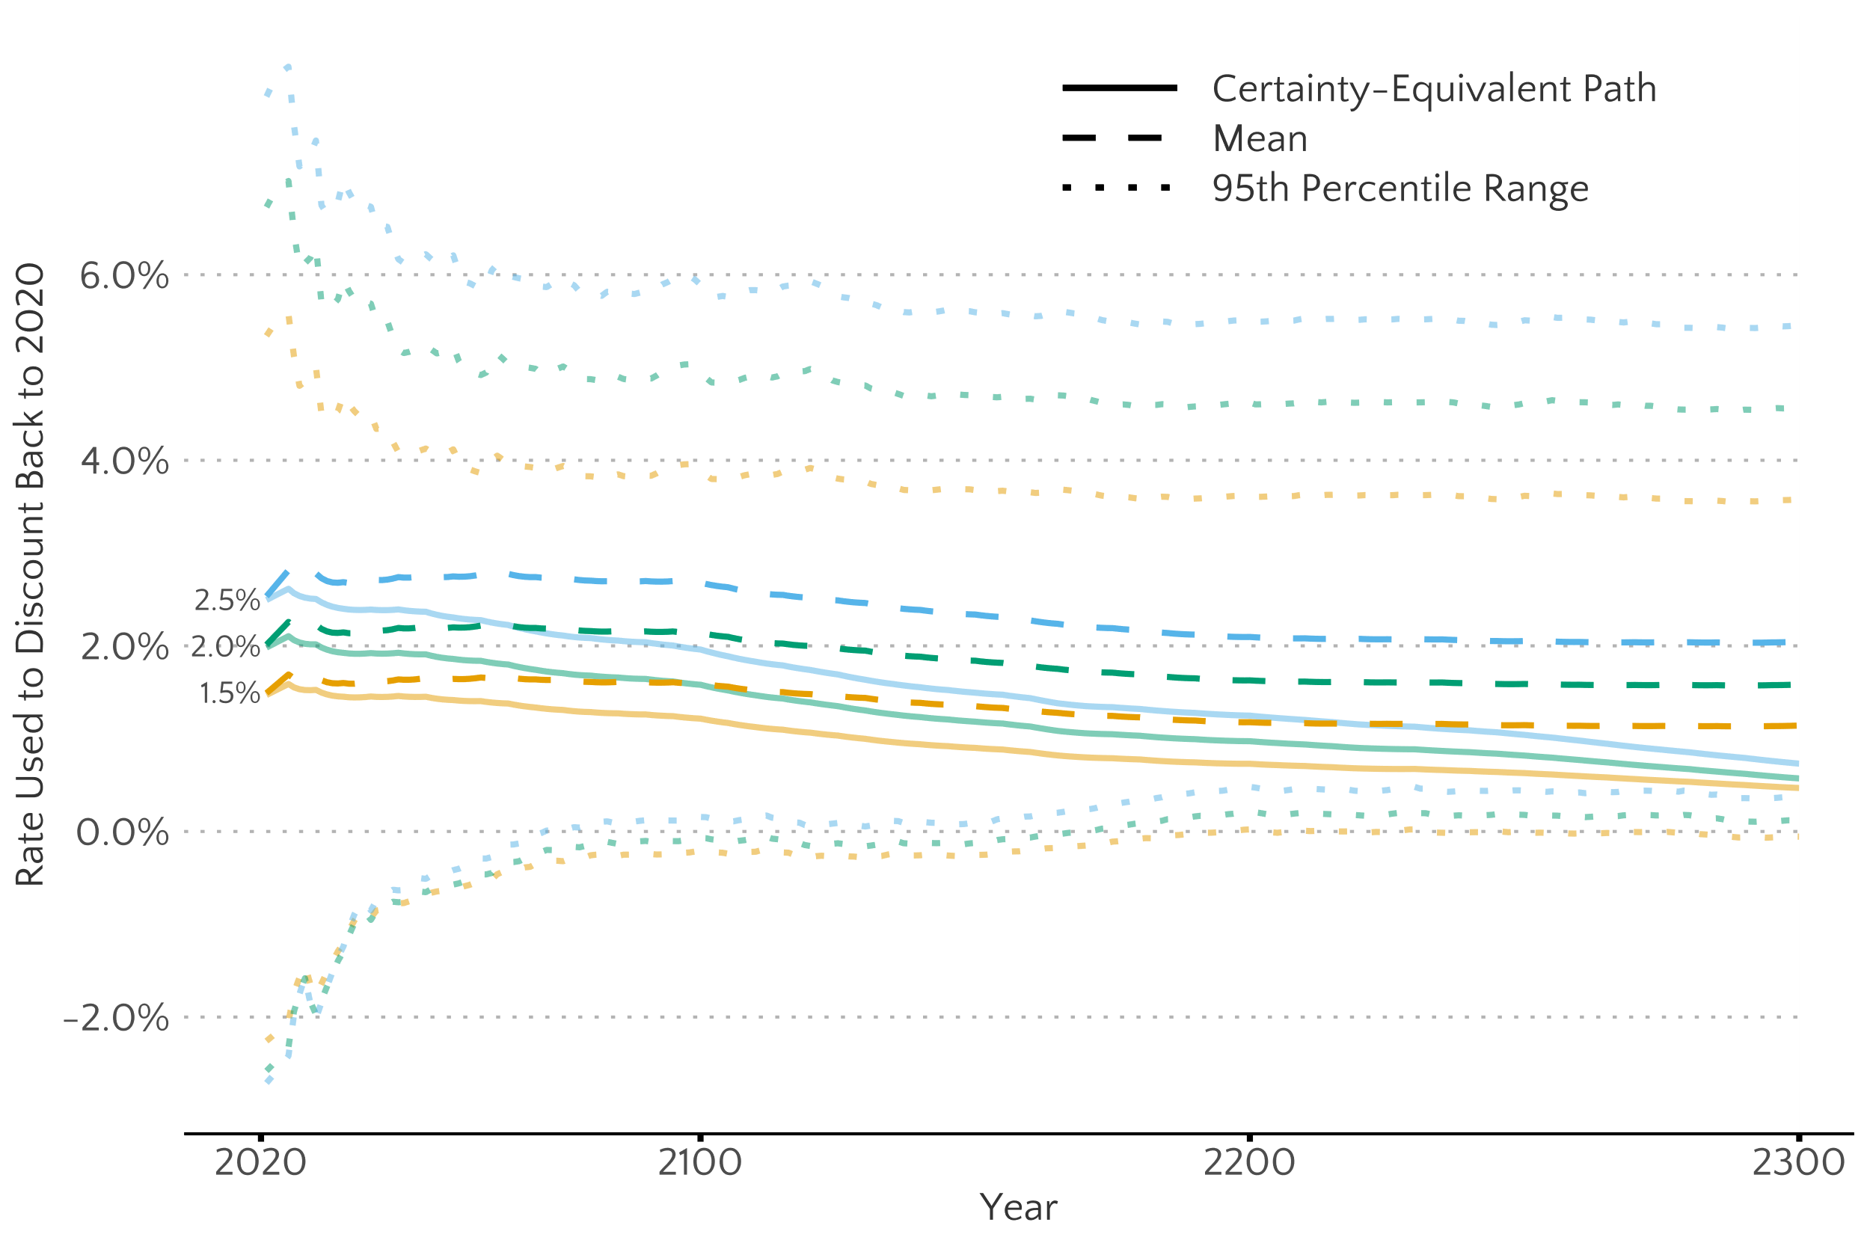
Appendix: Life Beyond DICE - Rennert et al. (2022)
Dynamic growth-consistent discount rate

Slide 40
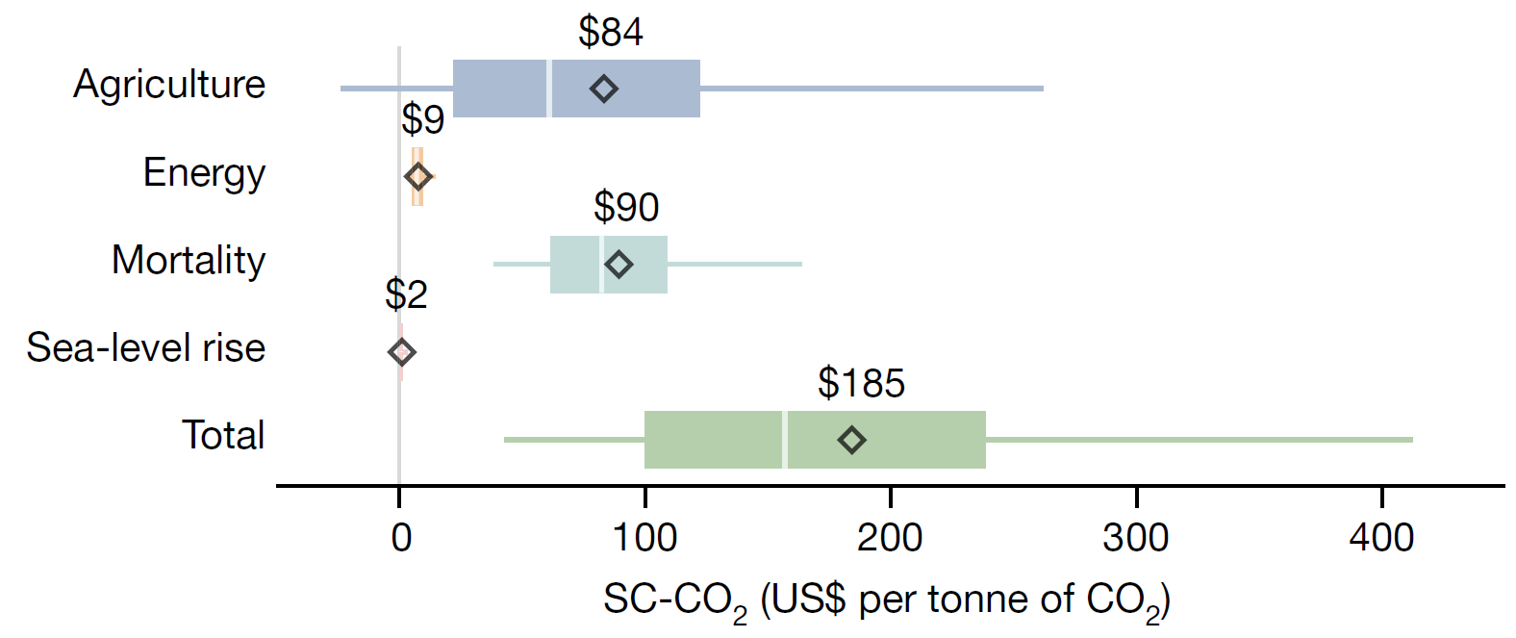
A
Appendix: Life Beyond DICE - Rennert et al. (2022)
A social cost of carbon dioxide that is thrice the USG estimate

